Slide 1
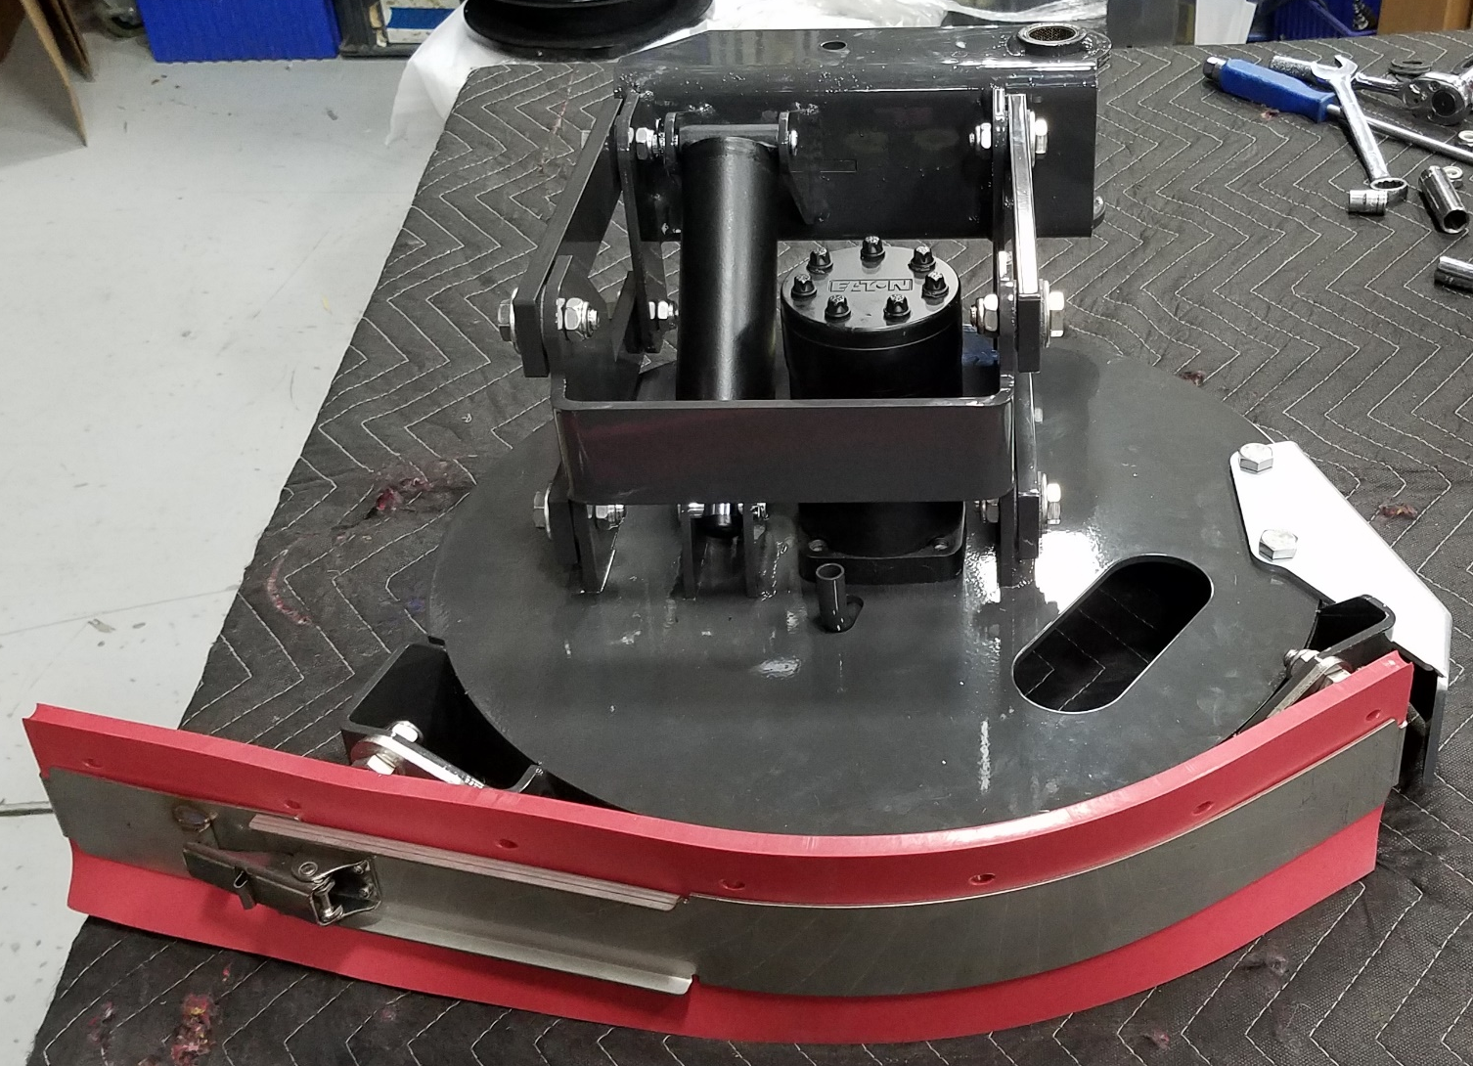
Assembly Instructions:
NAUTILUS SIDE SCRUB 888503
Pages 1-22

Slide 2
Component | Object Description | QTY | Storage Bin
730942 | WELDMENT, SSB MOUNT | 1 | B3008C02
730963 | WELDMENT, SSB GUARD | 1 | B3C01C01
730927 | WELDMENT, SSB SQU MNT | 1 | B3007F05
730938 | SSB SQU RETAINER | 1 | B3007F06
730652 | LATCH, UNDER CENTER | 1 | B3C01E02
730940 | WELDMENT, SSB REAR RET | 1 | B3C01F02
730939 | SQUEEGEE – SSB LINATEX | 1 | B3007C03
730892 | MOTOR, 9.7 DISP | 1 | A0812H02
675528 | FTG – ORFS 90 ELBOW -8 -10 SAE | 2 | A0614L04
3324451 | DRIVER – SCRUB BRUSH | 1 | D01LINE
730933 | WASHER, .28 B 1.25 OD .105 T SS | 1 | B3C01F02
730926-1 | SSB LINK, PAINTED | 4 | B3C01F02
730646 | BEARING, DU, .63B .72OD .38T | 8 | B3C02C01
730548 | CYLINDER – 1.5 BORE X 2.88 STROKE | 2 | B3101F03
675507 | FTG – ORFS 90 ELBOW -4 -4 SAE | 7 | B3004E05
675508 | FTG – ORFS STR THD -4 -4 SAE | 2 | A0615K04

Slide 3
Component | Object Description | QTY | Storage Bin
730925 | SSB ADJ TUBE | 1 | A0715A01
3311977 | ROD END – MALE 1/2-20 | 1 | A0814A01
730648 | SPACER, .406 X .624OD .515T SS | 8 | B3C02F01
730647 | WASHER, THRUST, .66B 1.25OD .06T | 16 | B3004E11
730910 | WELDMENT, SSB ARM | 1 | B3007C06
600174 | BEARING, FIBERGLIDE, 1.00 ID 1.00T | 2 | DC101B01
730964 | MOUNT, SSB MANIFOLD | 1 | A0708G03
730795-1 | MANIFOLD ASSY, SSB | 1 | A0710G03
675509 | FTG – ORFS TEE -4 -4 -4 SAE | 1 | A0614H03
675523 | FTG – ORFS 90 ELBOW -8 -8 SAE | 2 | A0614K03
675524 | FTG – ORFS STR THD -8 -8 SAE | 2 | A0614K04

Slide 4
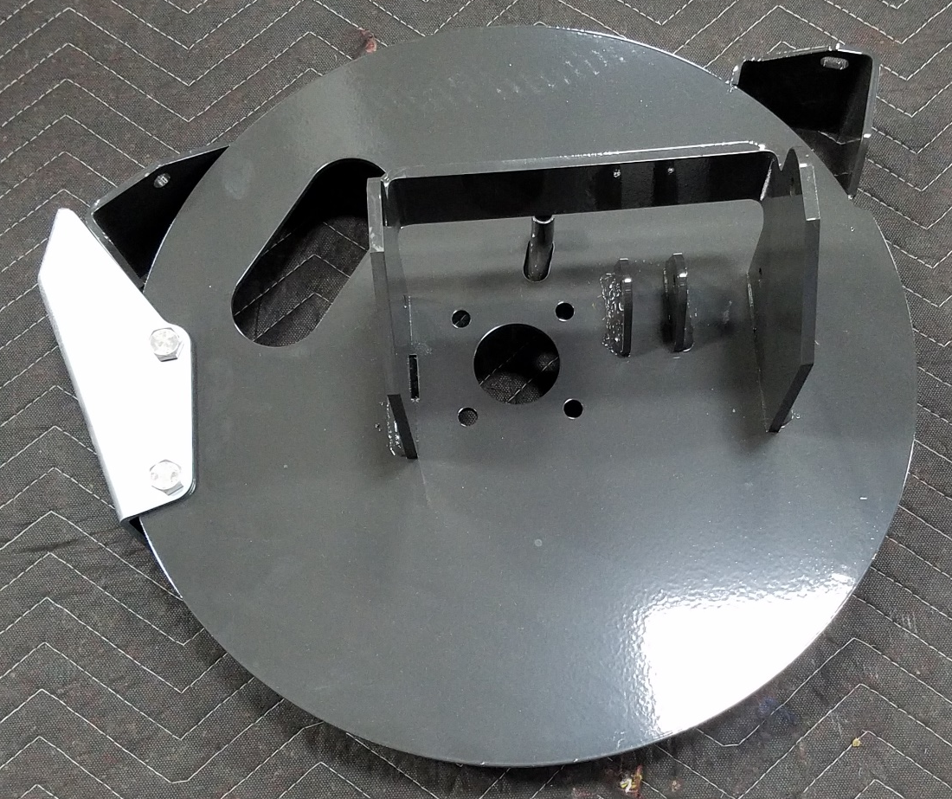
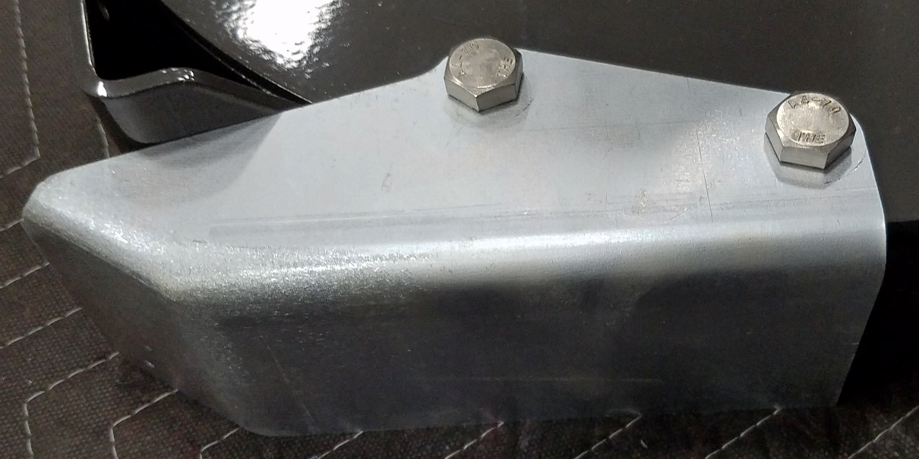
730942
(2)730958
(2)730339
730963

Slide 5
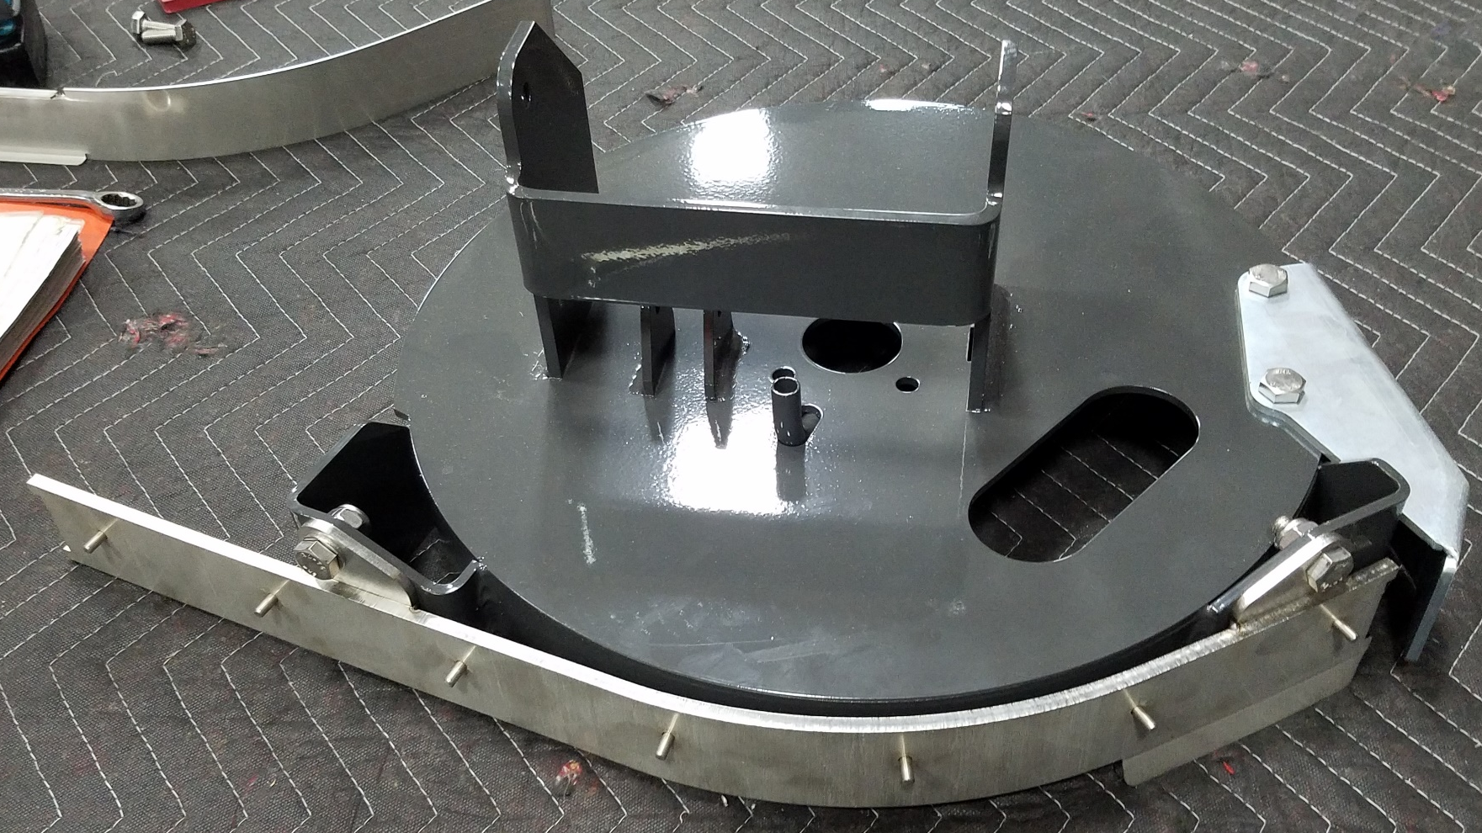
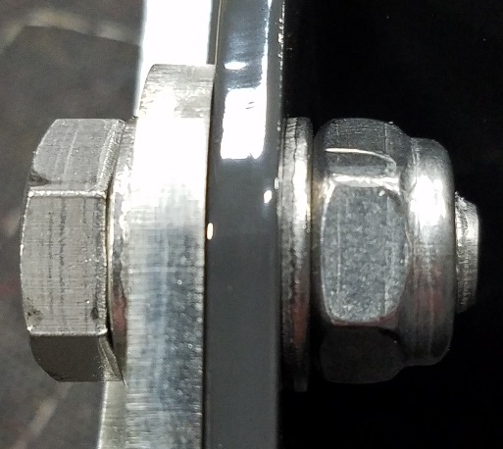
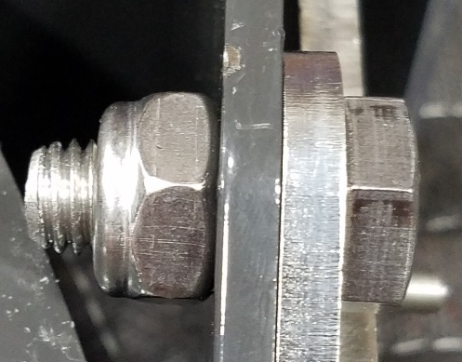
(2)730344
730927
730958
730958
730339
730339

Slide 6
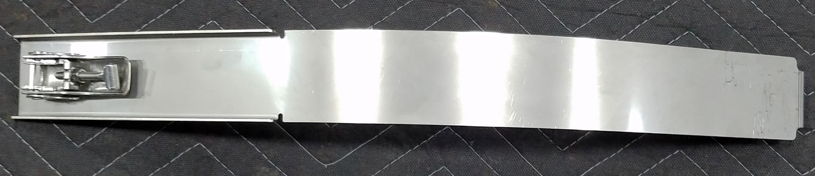
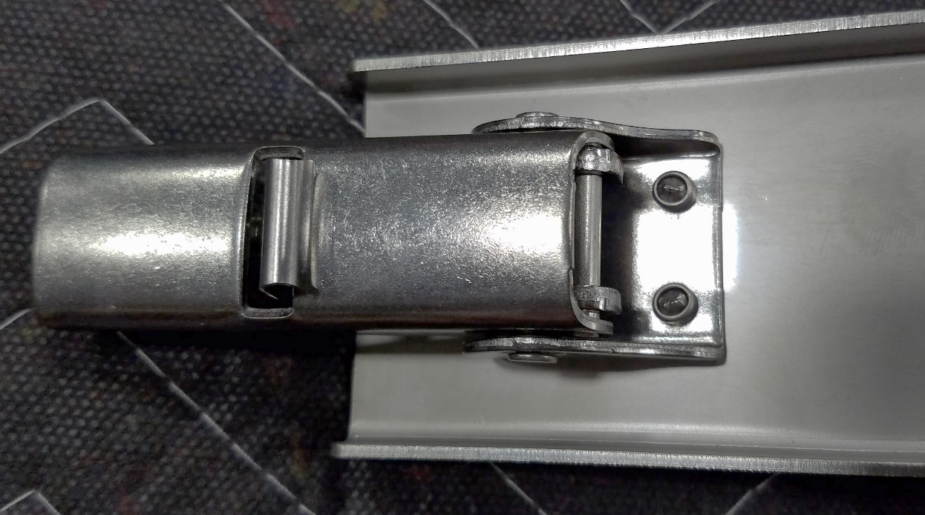
730938
730652
(2)730654
NOTE: Install RIVETS as shown

Slide 7
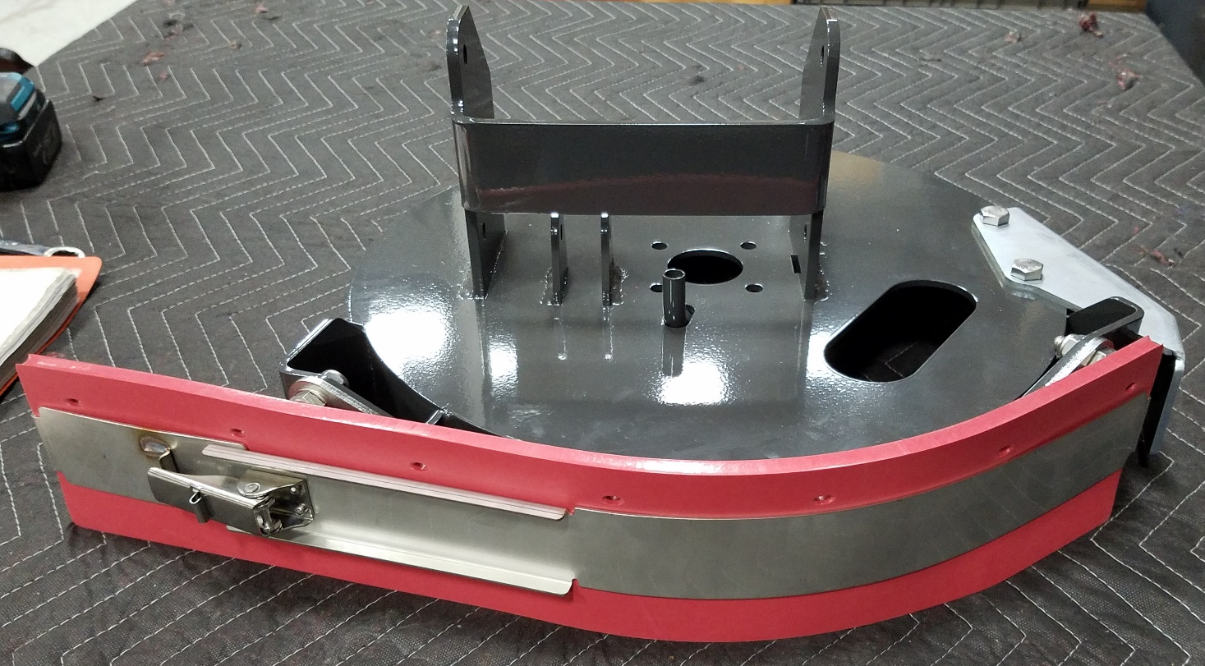
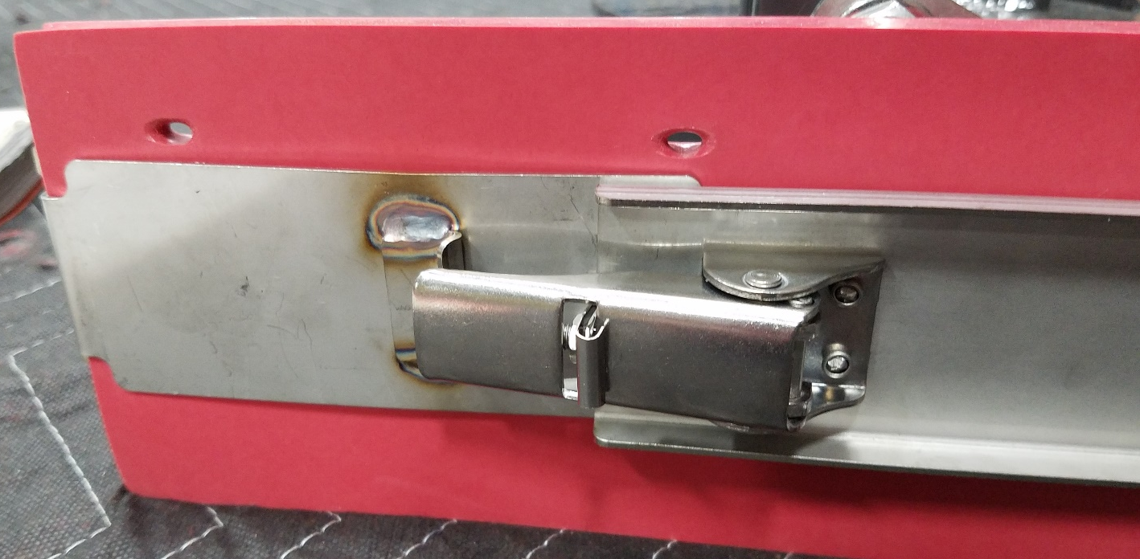
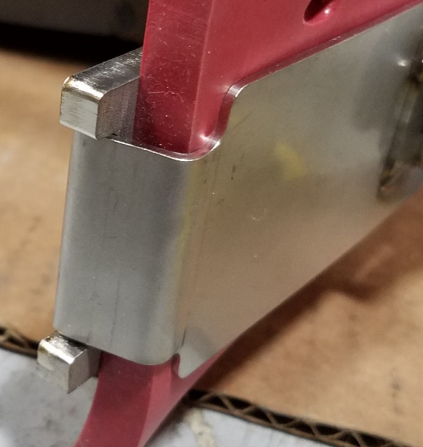
730939
NOTE: Install 730940 as shown
730940
730938 from earlier

Slide 8
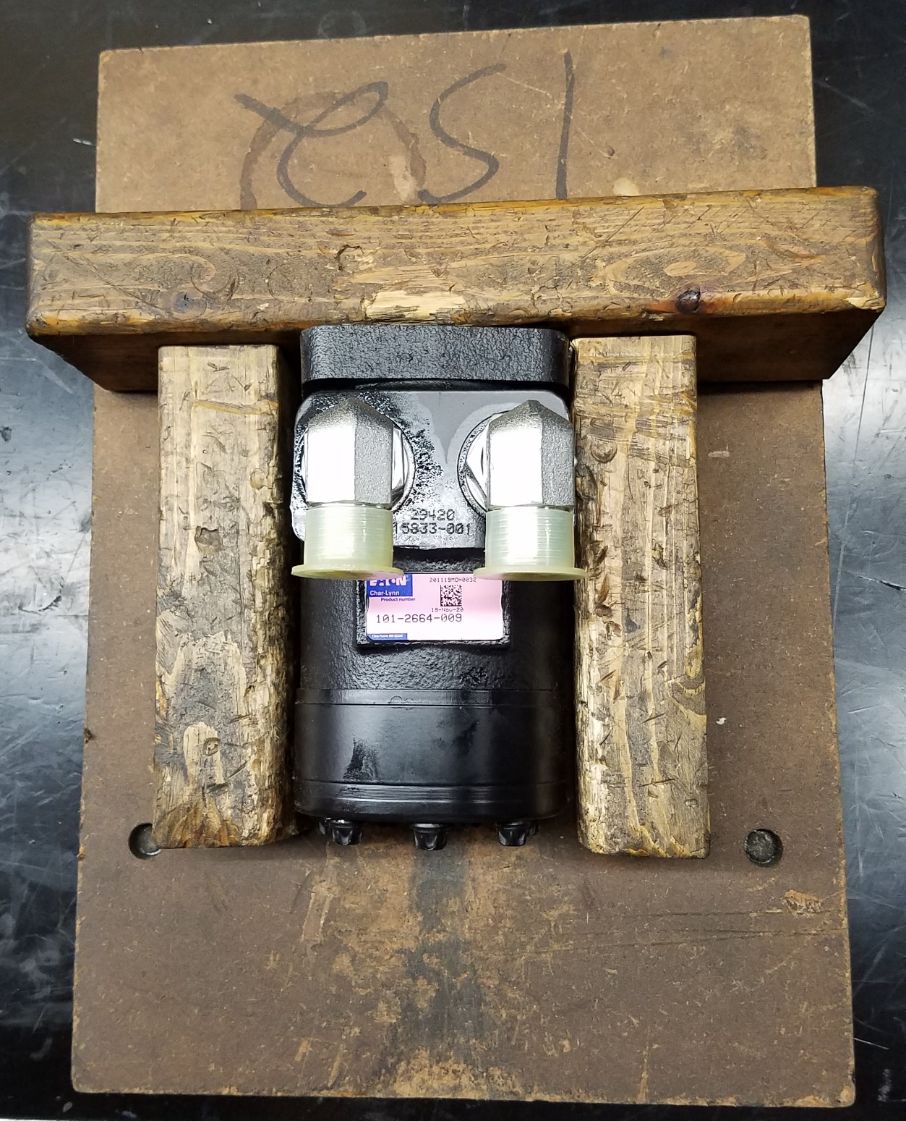
NOTE: Orient FITTINGS as shown
(2)675528
A0614L04
730892
A0812H02

Slide 9
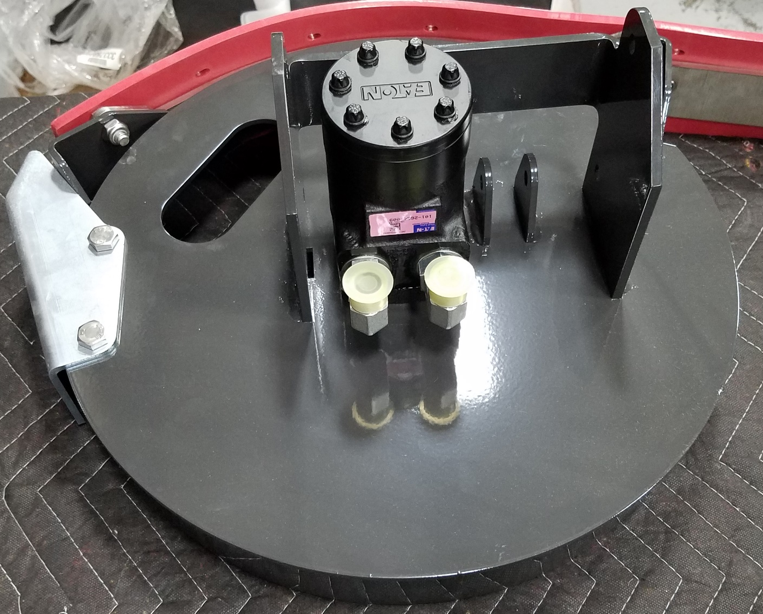
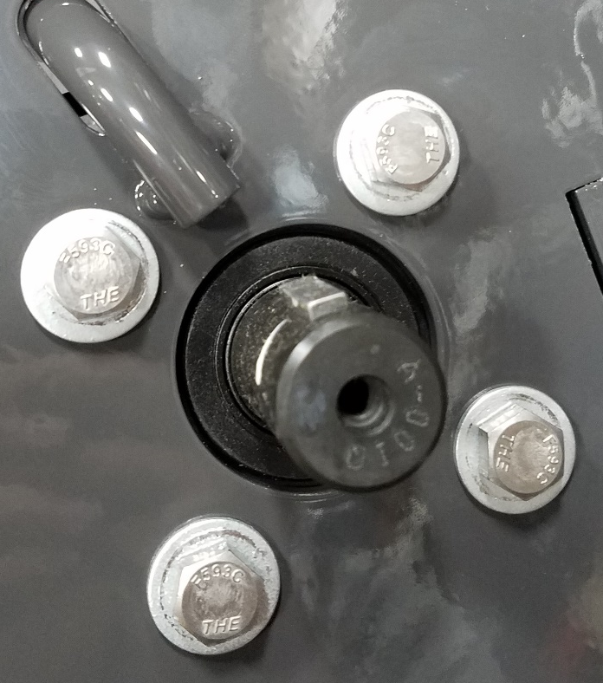
(4)730959
(4)3400385

Slide 10
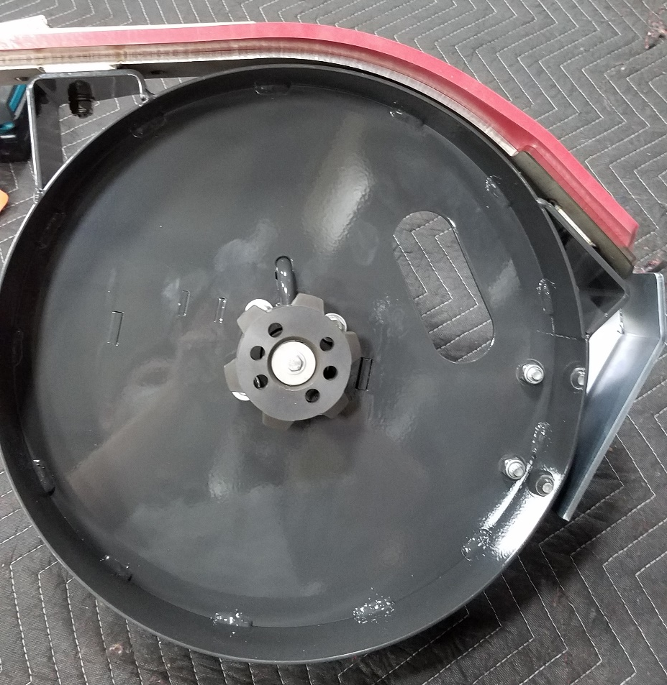
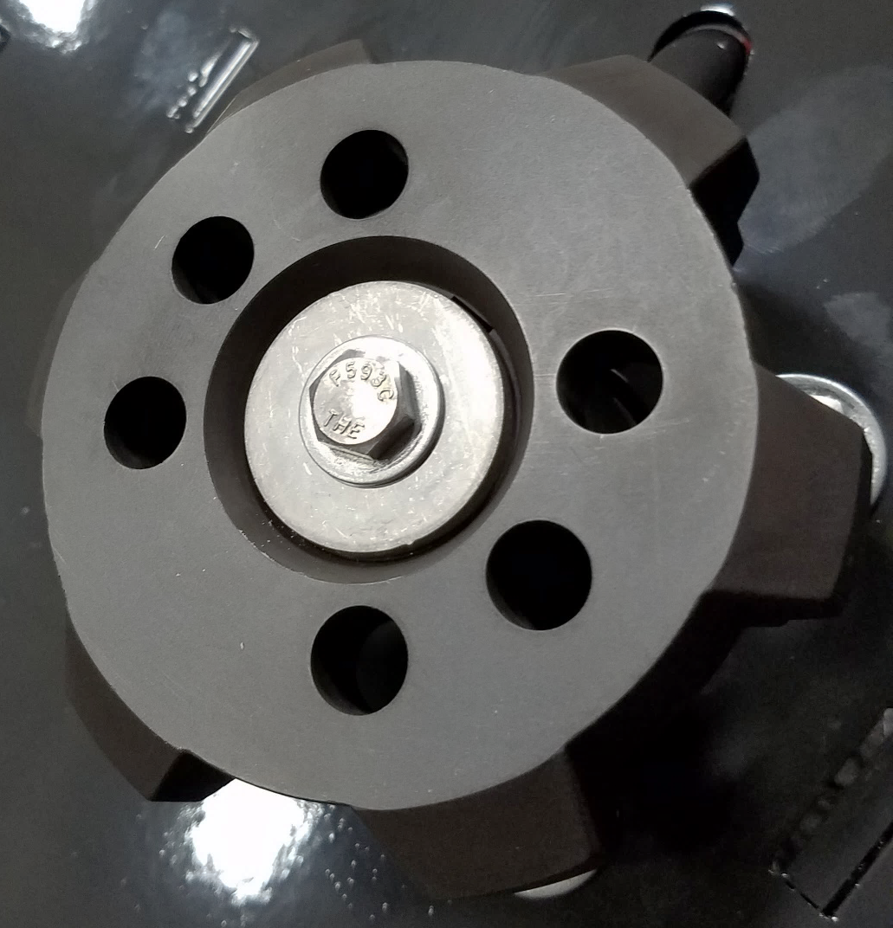
3324451
712566
730933
3400383

Slide 11
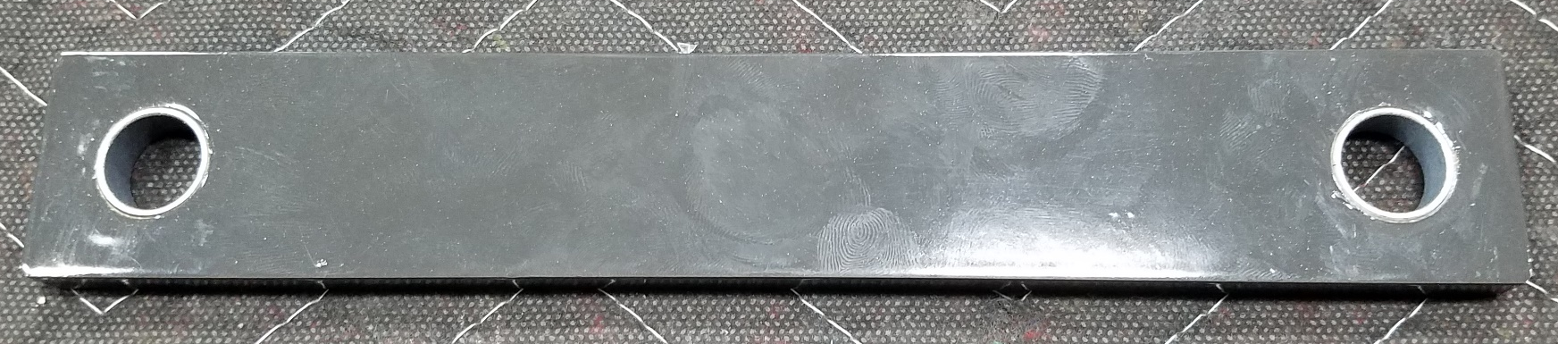
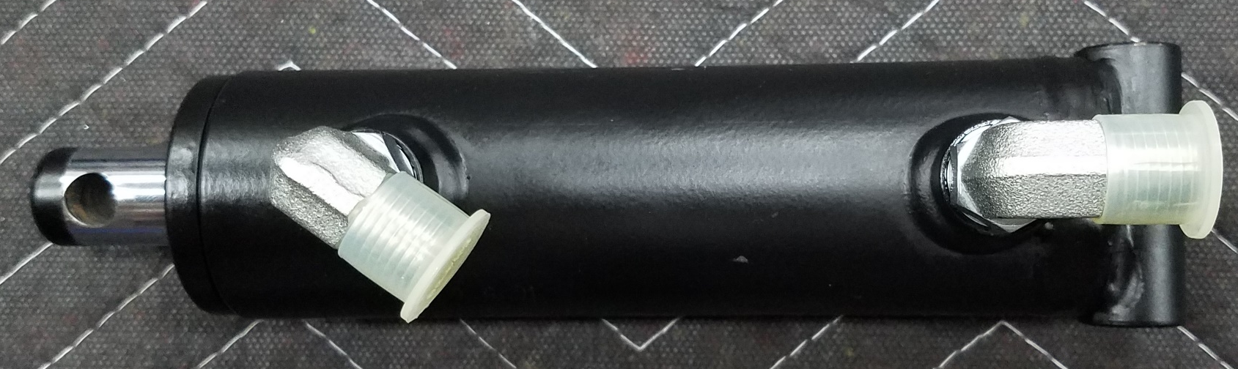
730926-1
Assemble (4) LINKS (730926-1) with (8) BEARINGS (730646)
(2)730646
(2)675507
B3004E05
730548
B3101F03
NOTE: Orient FITTINGS as shown

Slide 12
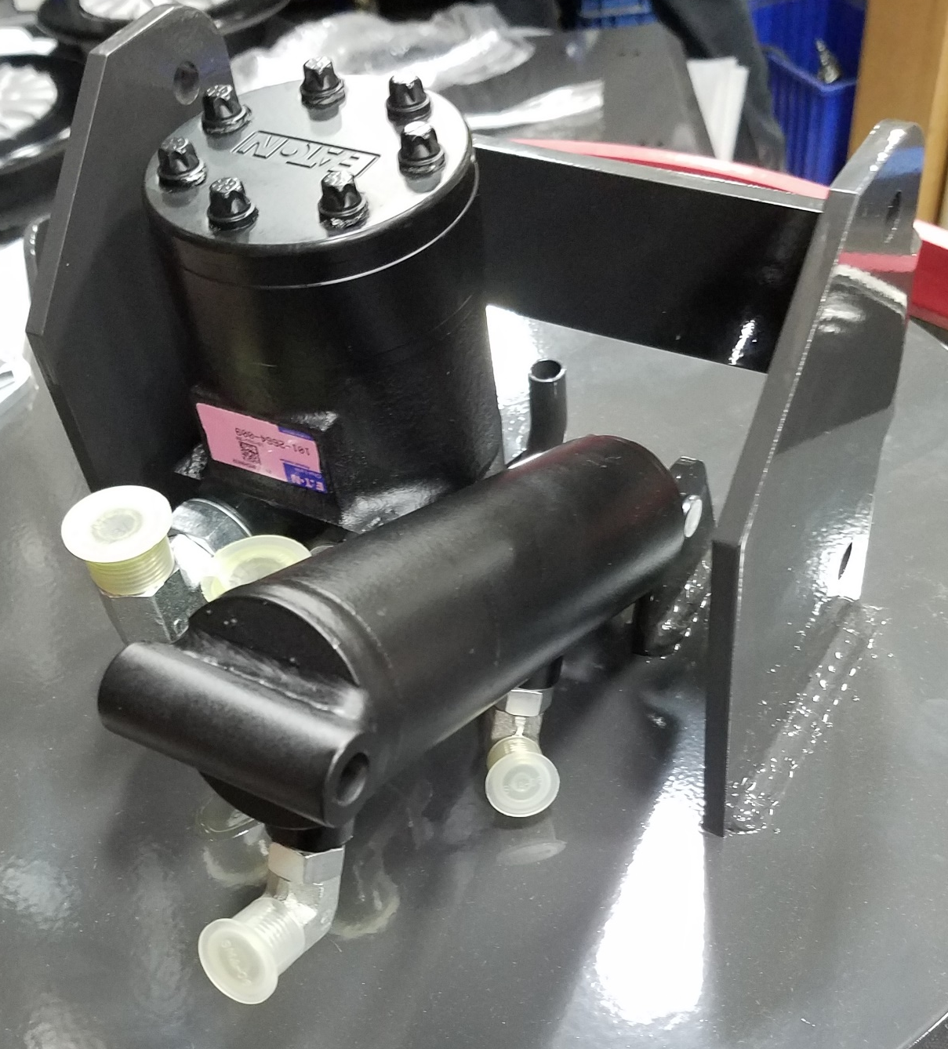
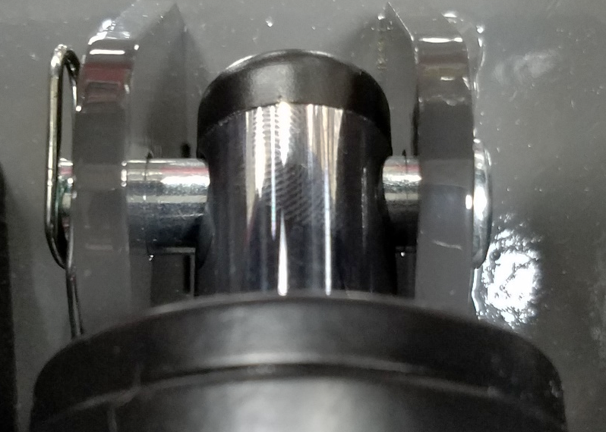
3400125
600573

Slide 13
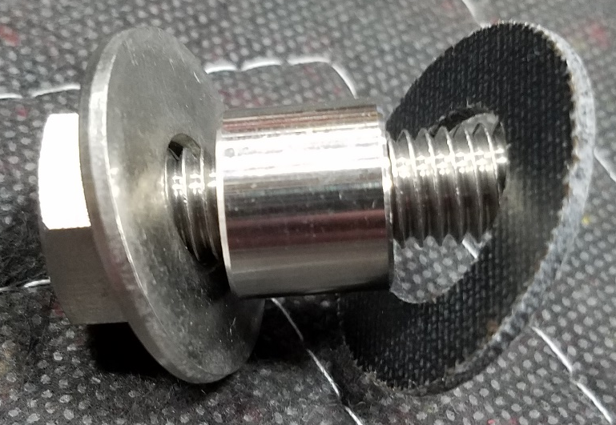
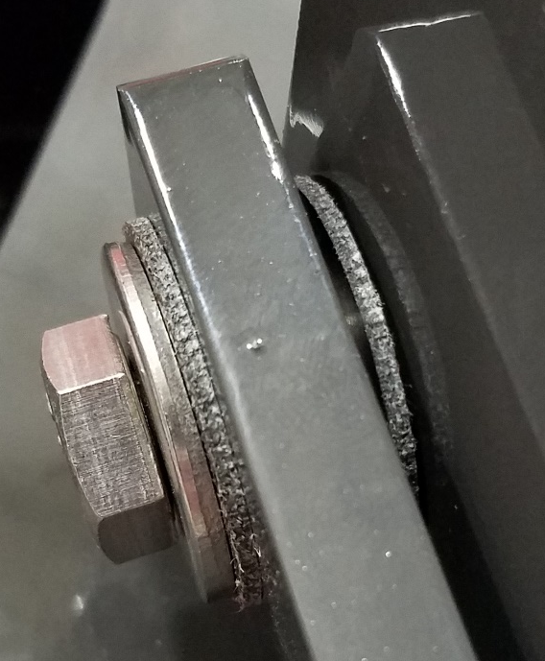
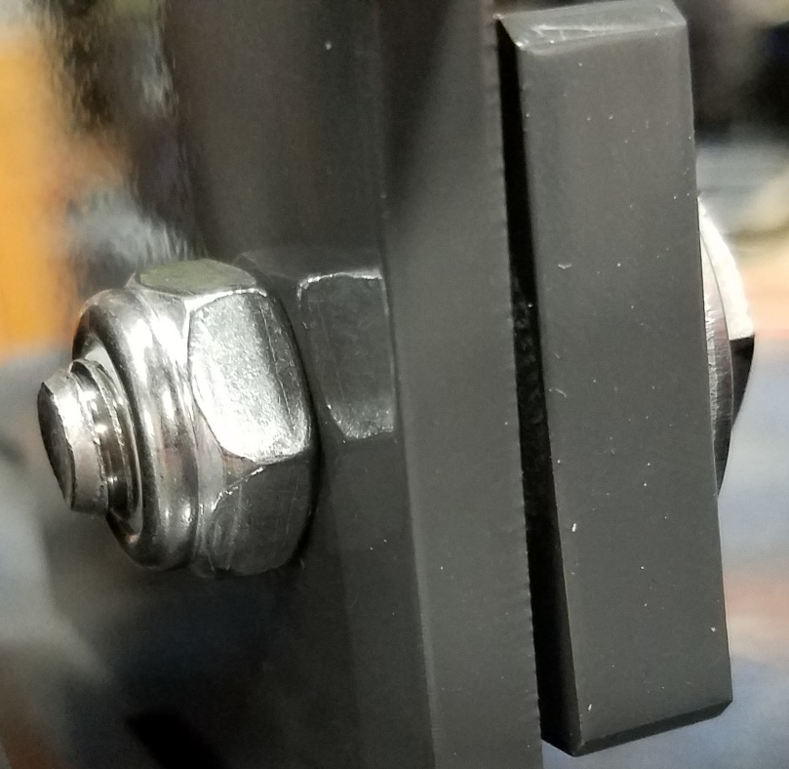
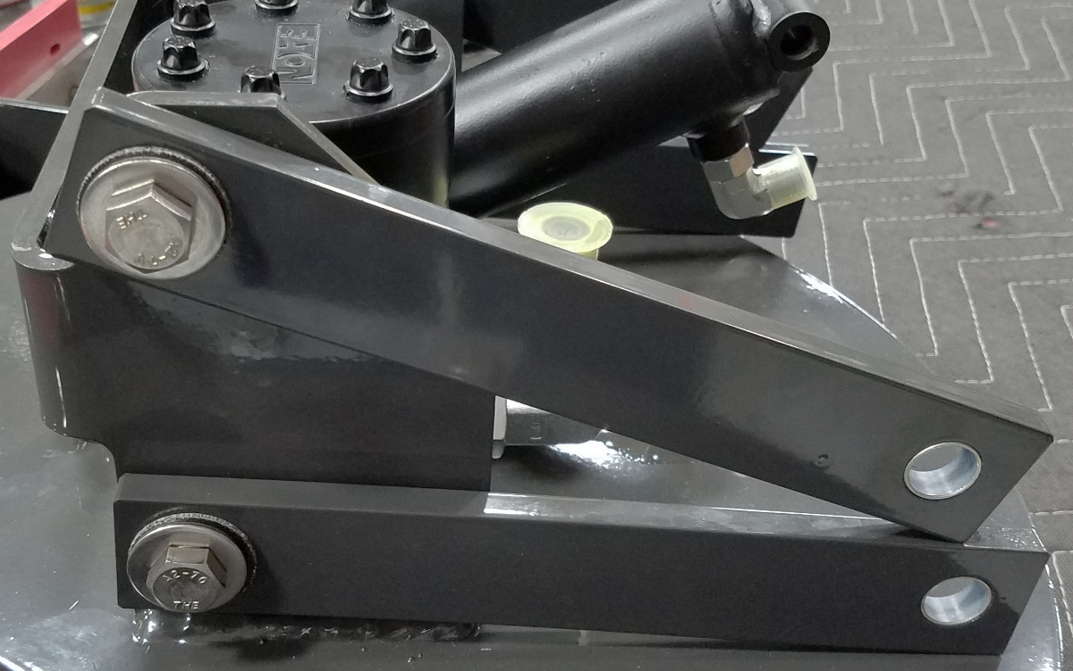
730345
717040
730647
730647
730648
NOTE: Repeat on other side
730339
(2)730926-1
Assembled earlier

Slide 14
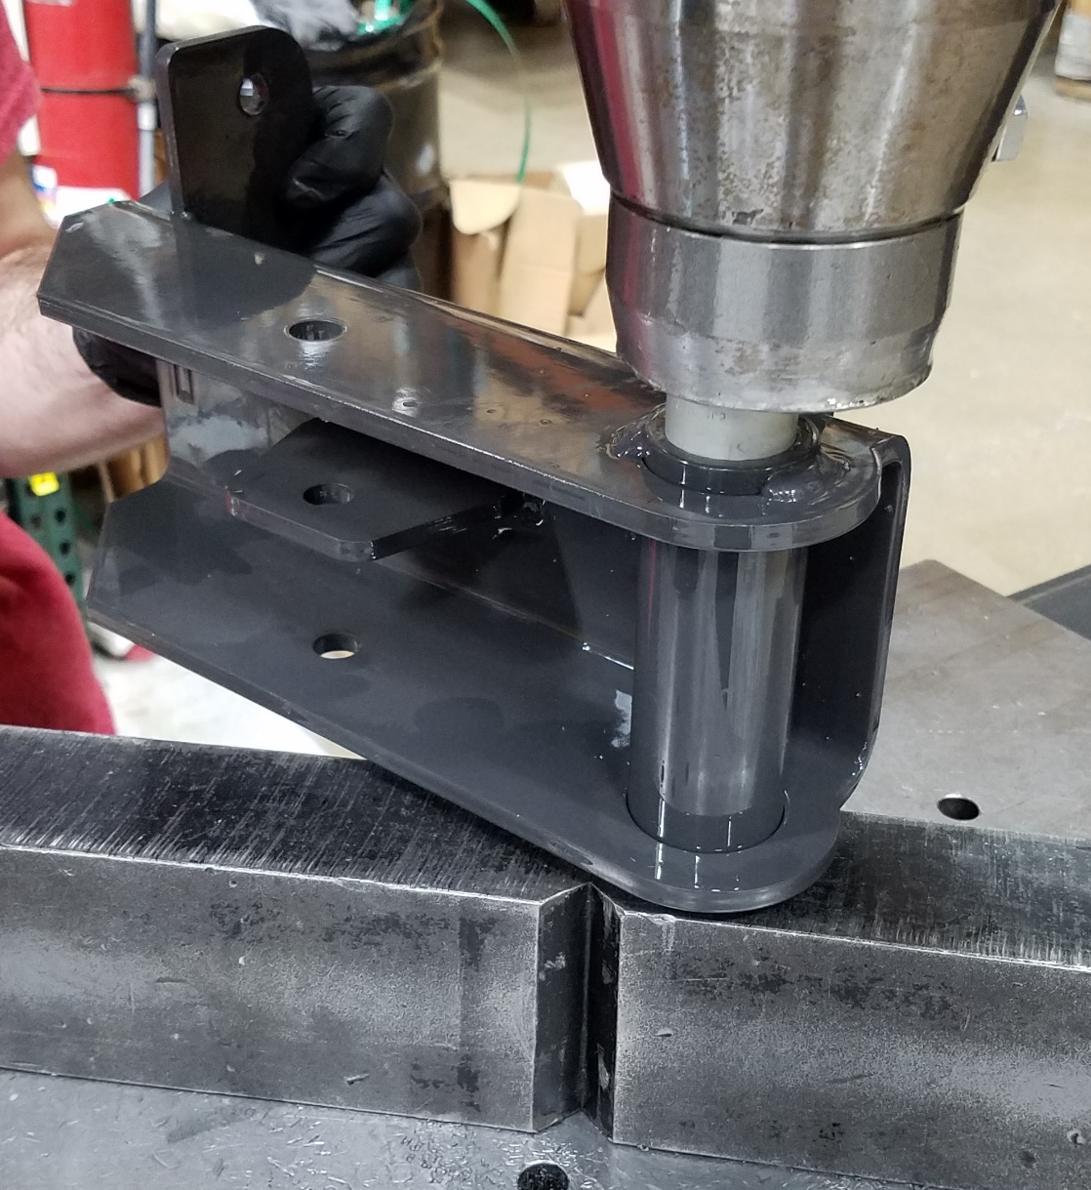
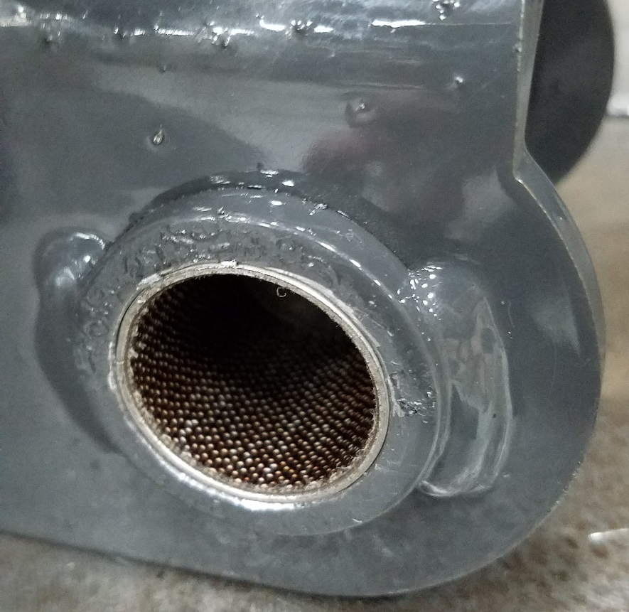
NOTE: 730910 may need to be reamed out for (2) BEARINGS (600174)
NOTE: Repeat on other side
600174
730910

Slide 15


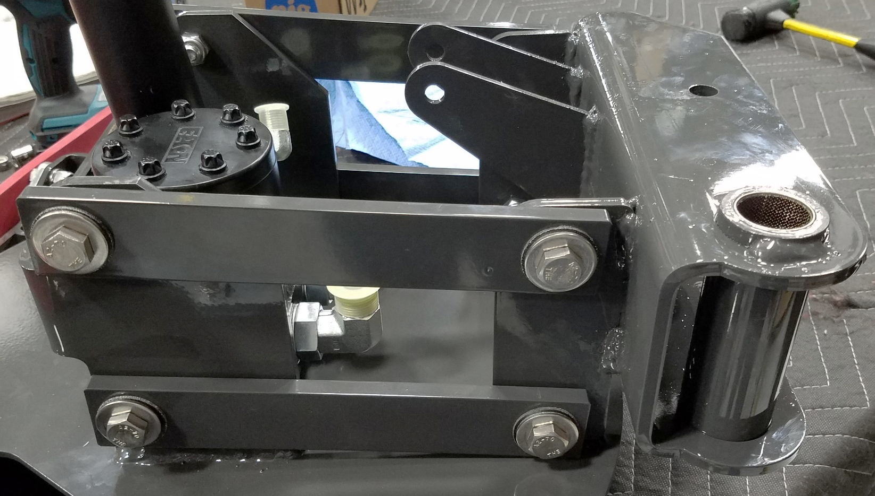
717040
(2)730647
730339
730345
730648
NOTE: Repeat on other side
730910
From earlier

Slide 16
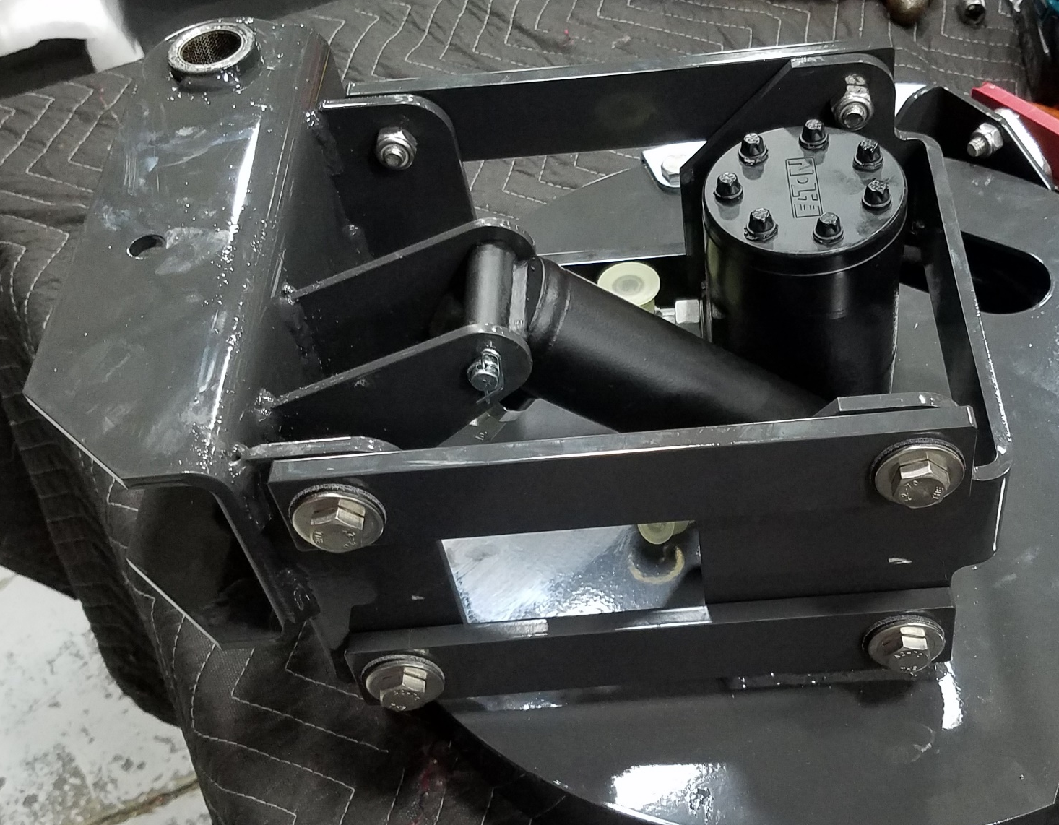
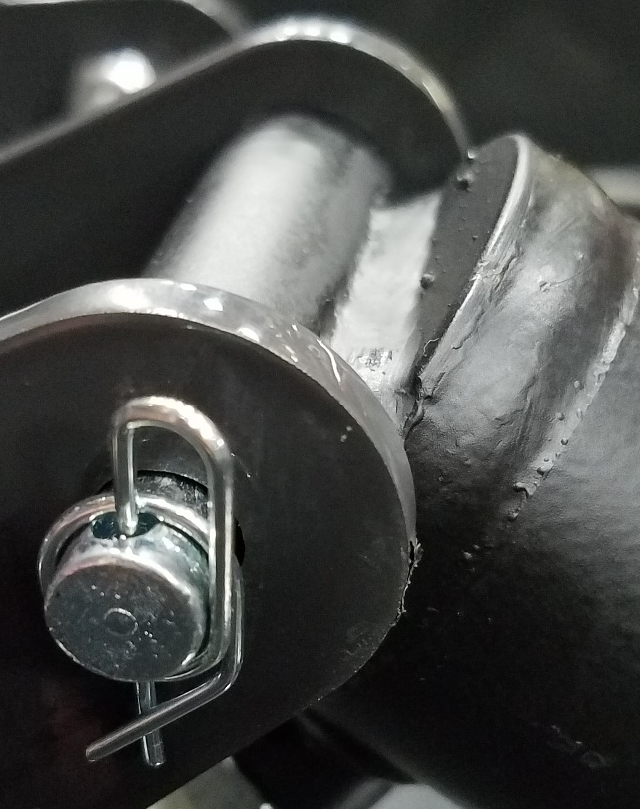
730602
FAS04I04
Bench 5B
3400125
MIN02J05
Bench 5B

Slide 17
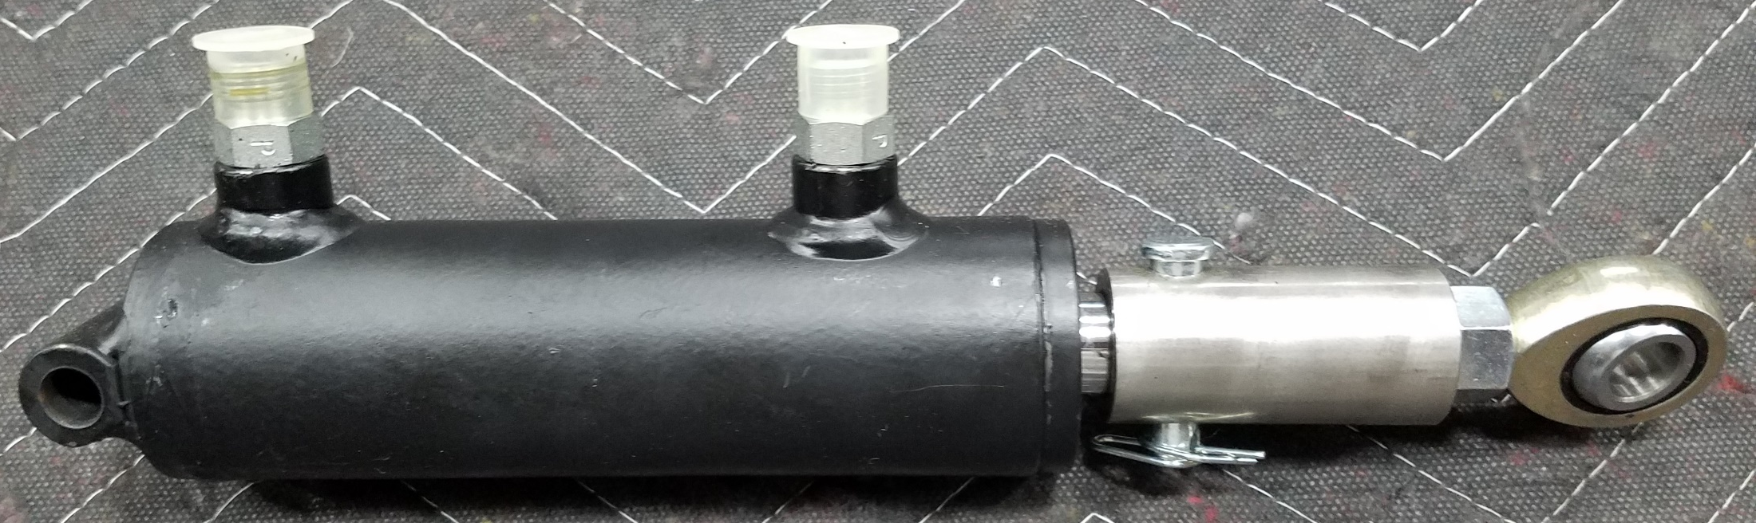
(2)675508
A0615K04
600573
711337
730548
B3101F03
3400125
730925
A0715A01
3311977
A0814A01

Slide 18
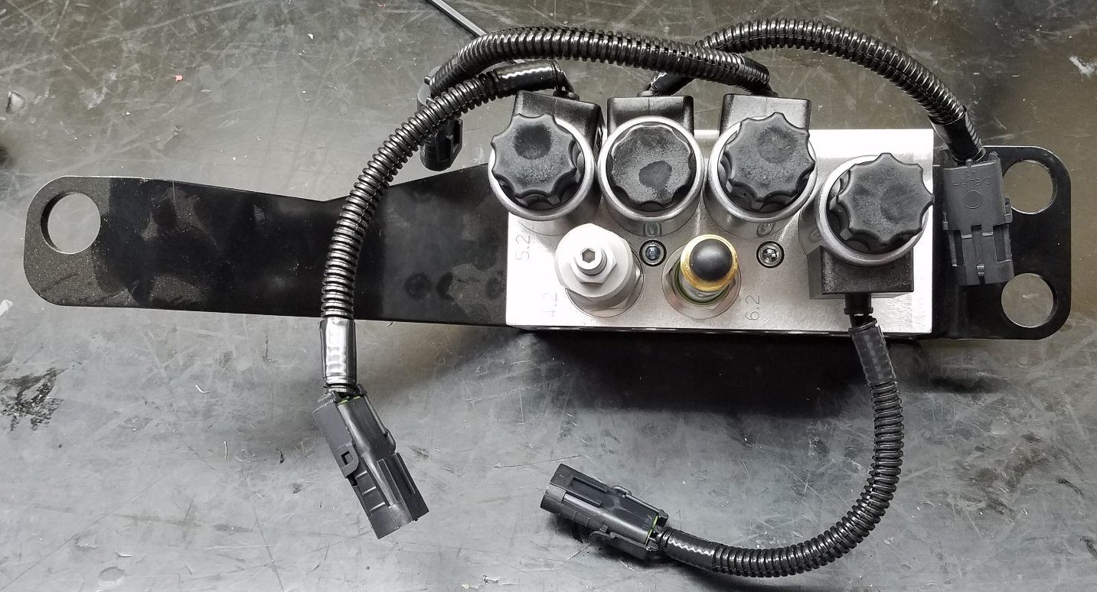
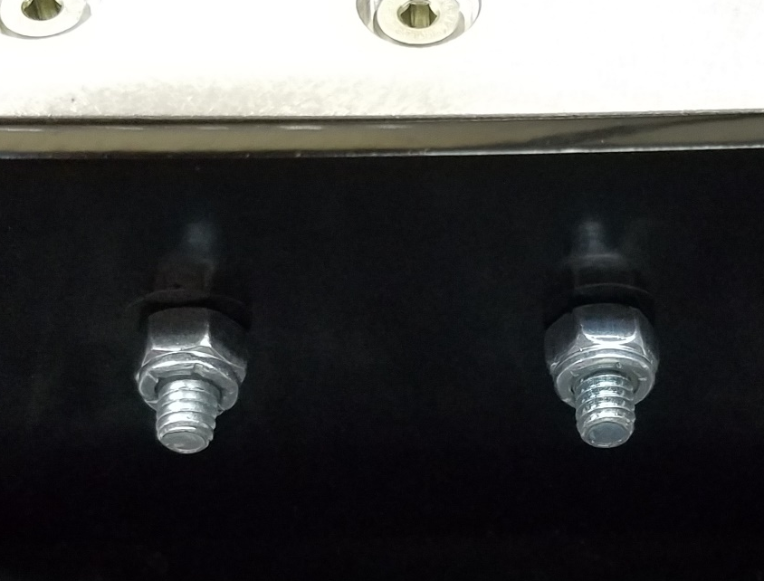
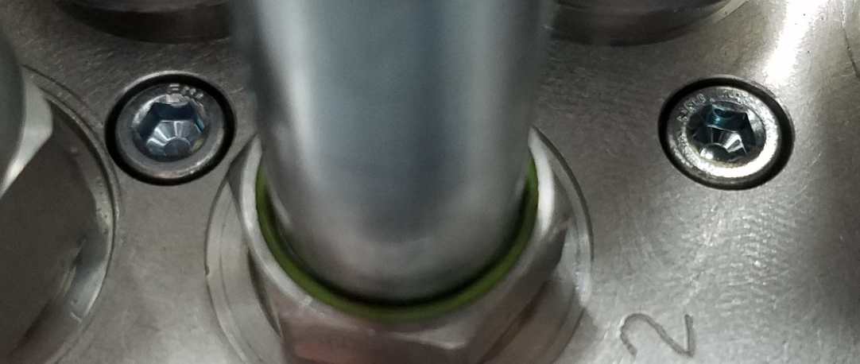
730795-1
A0710G03
NOTE: Remove SOLENOID to install SCREWS
730964
A0708G03
(2)711373
FAS02C04
Bench 3
(2)730965
FAS07J05
Bench 3

Slide 19
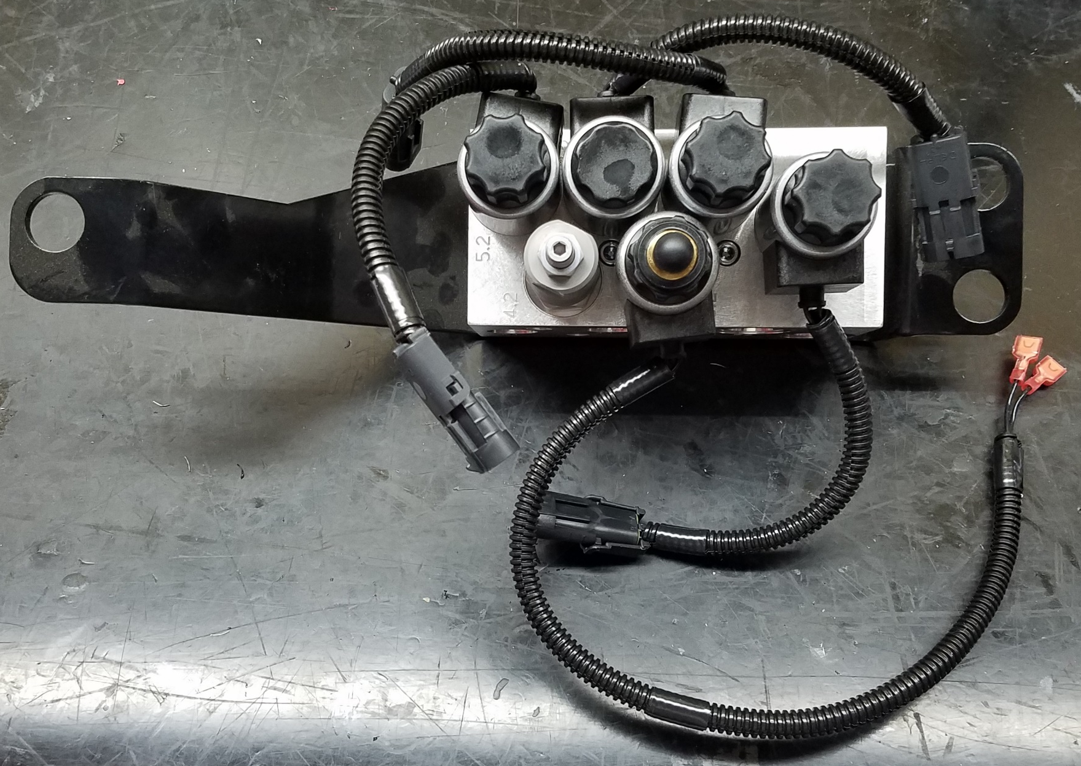
NOTE: Reinstall SOLENOID

Slide 20
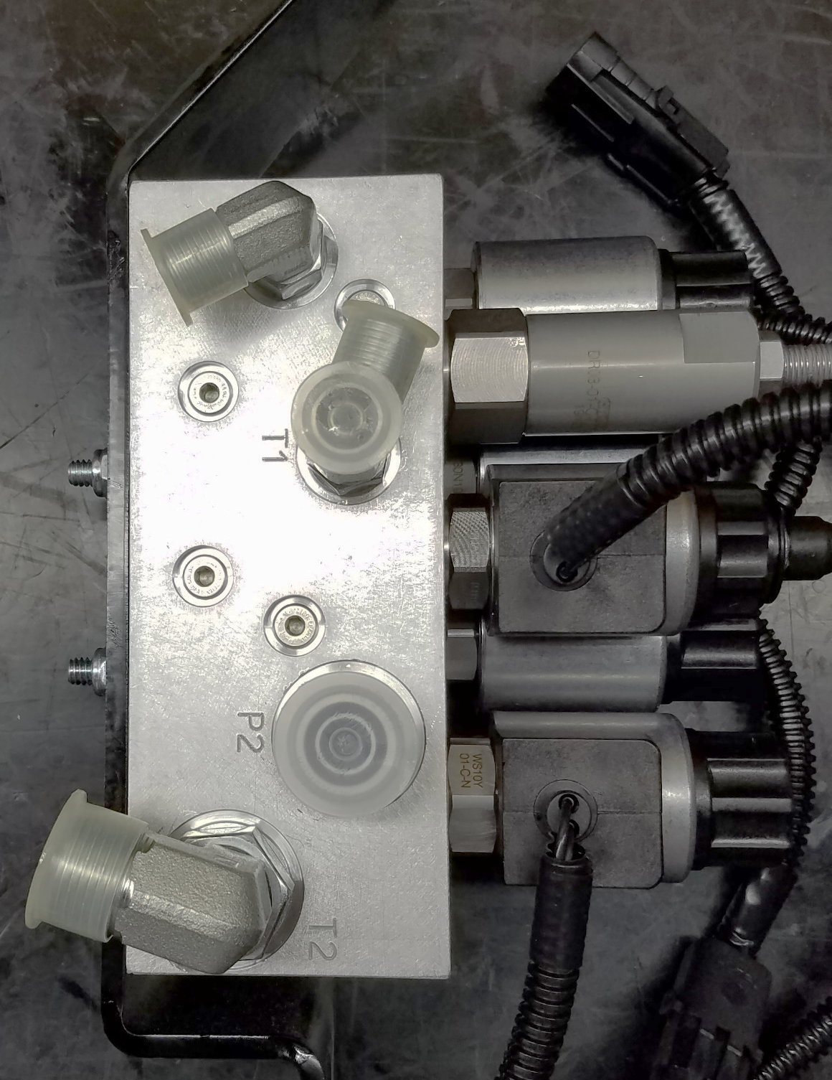
NOTE: Orient FITTINGS as shown
675507
B3004E05
675509
A0614H03
675524
A0614K04
675523
A0614K03

Slide 21
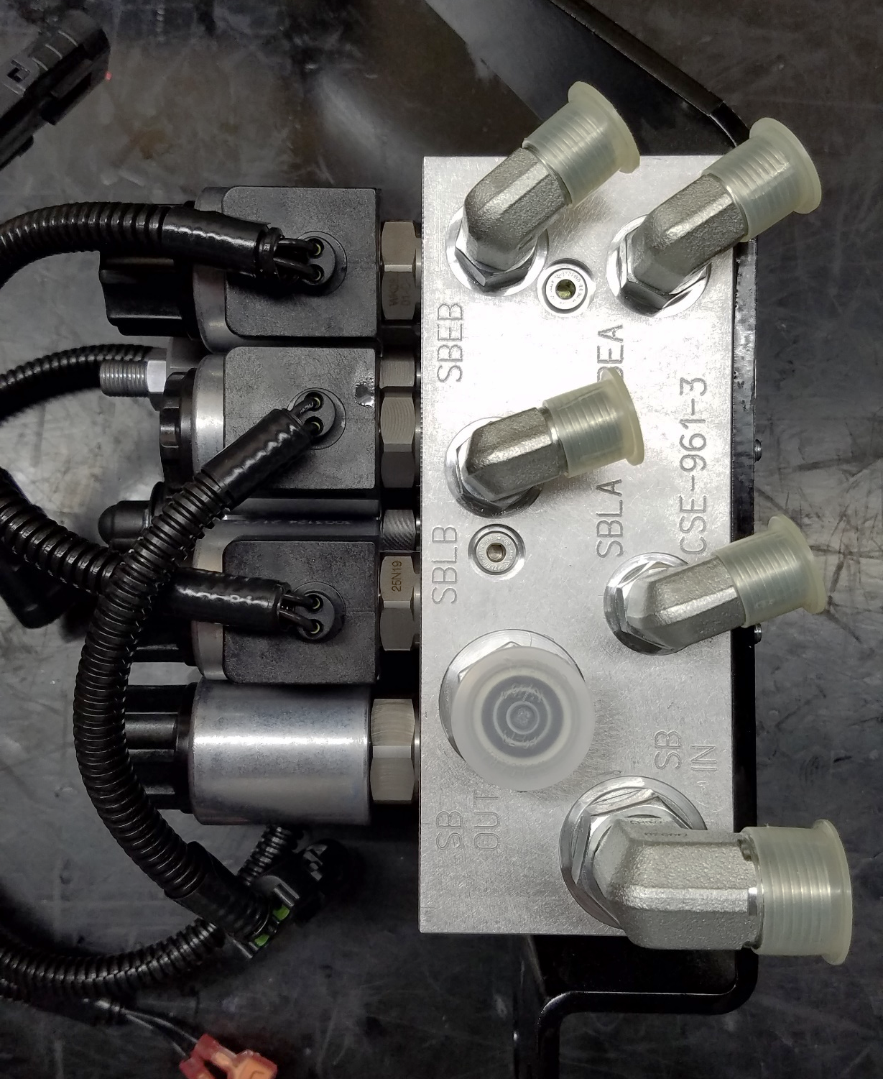
NOTE: Orient FITTINGS as shown
(4)675507
B3004E05
675524
A0614K04
675523
A0614K03

Slide 22
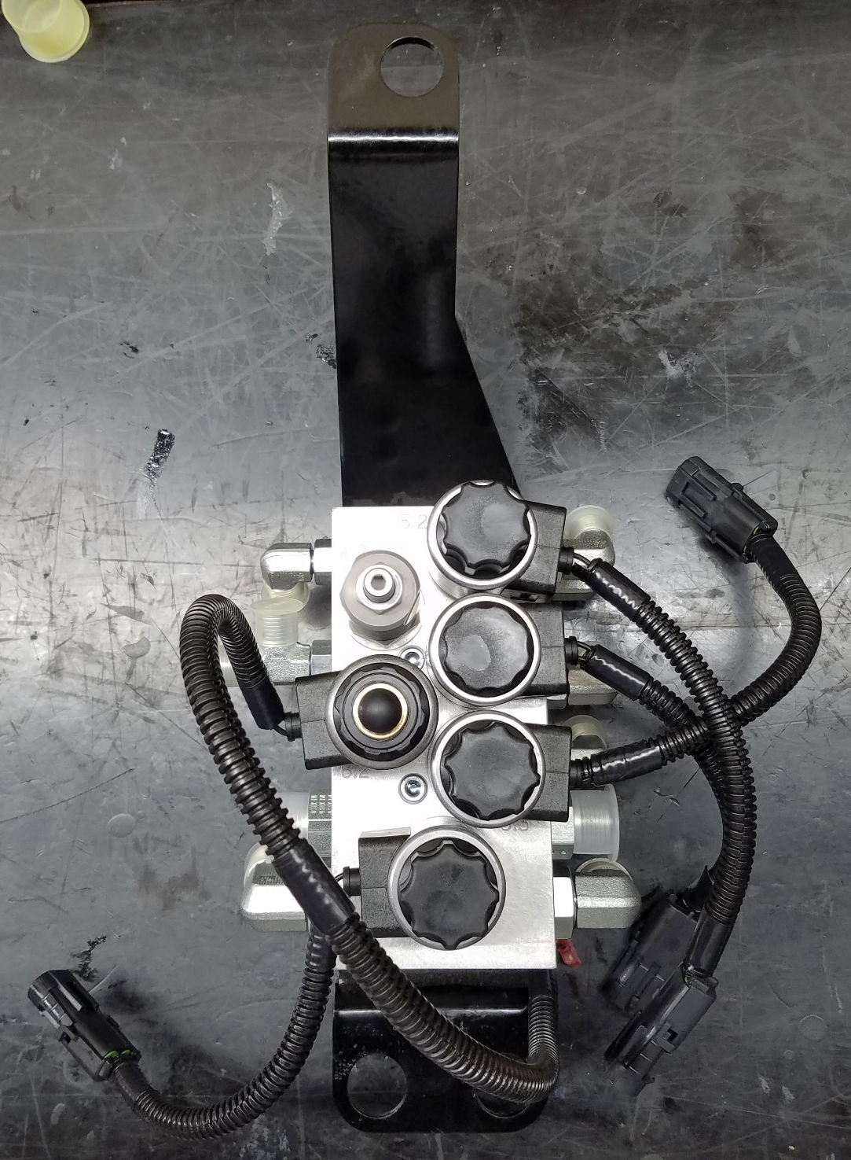
COMPLETED

